Slide 1
Version Control Systems
-- Kranthi Kavuri

Slide 2
VCS
Version control is a system that records changes to a file or set of files over time so that you can recall specific versions later. For the examples in this book you will use software source code as the files being version controlled, though in reality you can do this with nearly any type of file on a computer.

Slide 3

Local Version Control Systems
Many people’s version-control method of
choice is to copy files into another
directory (perhaps a time-stamped directory,
if they’re clever). This approach is very
common because it is so simple,
but it is also incredibly error prone.
It is easy to forget which directory you’re in
and accidentally write to the wrong file or copy over
files you don’t mean to.
To deal with this issue, programmers long ago developed local VCSs that had a simple database that kept all the changes to files under revision control.

Slide 4
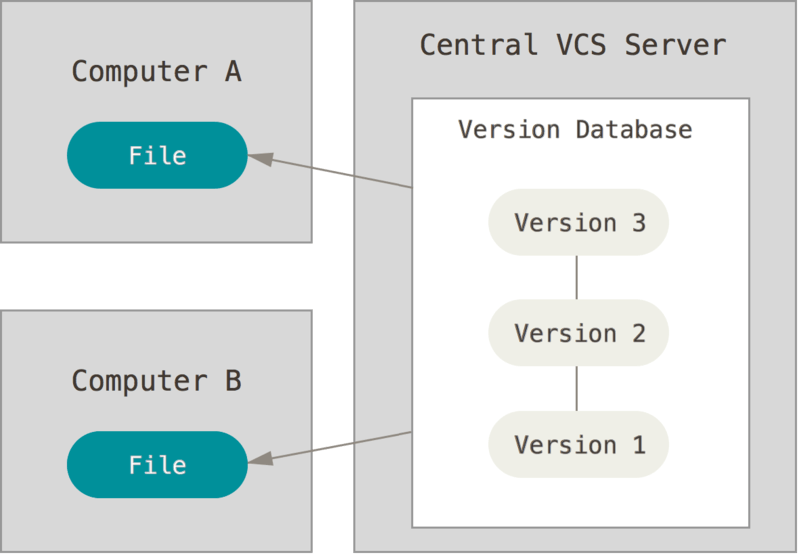
Centralized Version Control Systems
The next major issue that people encounter is that they need to collaborate with developers on other systems. To deal with this problem, Centralized Version Control Systems (CVCSs) were developed. These systems, such as CVS, Subversion, and Perforce, have a single server that contains all the
versioned files, and a number of clients
that check out files from that central
place

Slide 5
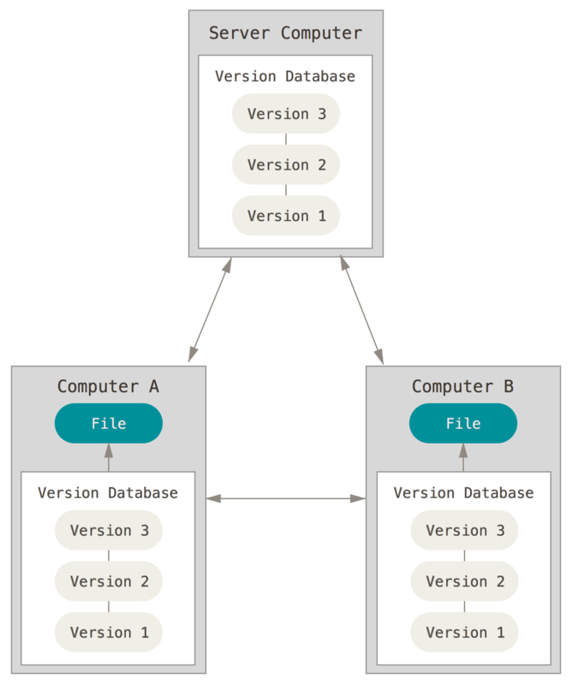
Distributed Version Control Systems
In a DVCS (such as Git, Mercurial, Bazaar or Darcs),
clients don’t just check out the latest snapshot of
the files: they fully mirror the repository. Thus
if any server dies, and these systems were collaborating
via it, any of the client repositories can be copied
back up to the server to restore it. Every clone is
really a full backup of all the data.

Slide 6
Benefits of VCS
Centralized Repository
Revision history
Branching and tagging
Learning curve is minimal
Automatic backups

Slide 7
GIT
Git is a free open source distributed VCS used in software development.
In 2005, the relationship between the community that developed the Linux kernel and the commercial company that developed BitKeeper broke down, and the tool’s free-of-charge status was revoked. This prompted the Linux development community (and in particular Linus Torvalds, the creator of Linux) to develop their own tool based on some of the lessons they learned while using BitKeeper. Some of the goals of the new system were as follows:
Speed
Simple design
Strong support for non-linear development (thousands of parallel branches)
Fully distributed
Able to handle large projects like the Linux kernel efficiently (speed and data size)
Since its birth in 2005, Git has evolved and matured to be easy to use and yet retain these initial qualities. It’s incredibly fast, it’s very efficient with large projects, and it has an incredible branching system for non-linear development

Slide 8
Why the name GIT
Git is not an acronym. 'git' is British slang for a dumb, annoying, or generally unpleasant person. The joke is that Linus Torvalds (Linux creator) names his projects after himself, so he chose 'git' as the name of the SCM he made.

Slide 9
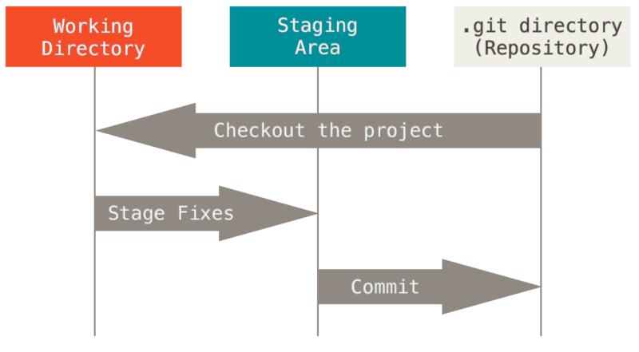
GIT Workflow
The basic Git workflow:
You modify files in your working tree.
You stage the files, adding snapshots of them to your staging area.
You do a commit, which takes the files as they are in the staging area and stores that snapshot permanently to your Git directory.

Slide 10
Command Line: The computer program we use to input Git commands. On a Mac, it’s called Terminal. On a PC, it’s a non-native program that you download when you download Git for the first time (we’ll do that in the next section). In both cases, you type text-based commands, known as prompts, into the screen, instead of using a mouse.
Repository: A directory or storage space where your projects can live. Sometimes GitHub users shorten this to “repo.” It can be local to a folder on your computer, or it can be a storage space on GitHub or another online host. You can keep code files, text files, image files, you name it, inside a repository.
Version Control: Basically, the purpose Git was designed to serve. When you have a Microsoft Word file, you either overwrite every saved file with a new save, or you save multiple versions. With Git, you don’t have to. It keeps “snapshots” of every point in time in the project’s history, so you can never lose or overwrite it.
Commit: This is the command that gives Git its power. When you commit, you are taking a “snapshot” of your repository at that point in time, giving you a checkpoint to which you can reevaluate or restore your project to any previous state.
Branch: How do multiple people work on a project at the same time without Git getting them confused? Usually, they “branch off” of the main project with their own versions full of changes they themselves have made. After they’re done, it’s time to “merge” that branch back with the “master,” the main directory of the project.

Slide 11
git init: Initializes a new Git repository. Until you run this command inside a repository or directory, it’s just a regular folder. Only after you input this does it accept further Git commands.
git config: Short for “configure,” this is most useful when you’re setting up Git for the first time.
git help: Forgot a command? Type this into the command line to bring up the 21 most common git commands. You can also be more specific and type “git help init” or another term to figure out how to use and configure a specific git command.
git status: Check the status of your repository. See which files are inside it, which changes still need to be committed, and which branch of the repository you’re currently working on.

Slide 12
git add: This does not add new files to your repository. Instead, it brings new files to Git’s attention. After you add files, they’re included in Git’s “snapshots” of the repository.
git commit: Git’s most important command. After you make any sort of change, you input this in order to take a “snapshot” of the repository. Usually it goes git commit -m “Message here.” The -m indicates that the following section of the command should be read as a message.
git branch: Working with multiple collaborators and want to make changes on your own? This command will let you build a new branch, or timeline of commits, of changes and file additions that are completely your own. Your title goes after the command. If you wanted a new branch called “cats,” you’d type git branch cats.
git checkout: Literally allows you to “check out” a repository that you are not currently inside. This is a navigational command that lets you move to the repository you want to check. You can use this command as git checkout master to look at the master branch, or git checkout cats to look at another branch.

Slide 13
git merge: When you’re done working on a branch, you can merge your changes back to the master branch, which is visible to all collaborators. git merge cats would take all the changes you made to the “cats” branch and add them to the master.
git push: If you’re working on your local computer, and want your commits to be visible online on GitHub as well, you “push” the changes up to GitHub with this command.
git pull: If you’re working on your local computer and want the most up-to-date version of your repository to work with, you “pull” the changes down from GitHub with this command.

Slide 14
Installing GIT
For installing the basic Git tools on Linux via a binary installer, you can do that using the basic package-management tool that comes with the Operating System distribution.
sudo apt-get install git-all
Follow the link to try git commands:
https://try.github.io/

